Slide 1
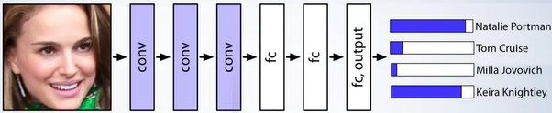
LX CNNs and RNNs
Z. Gu 2021

Slide 2
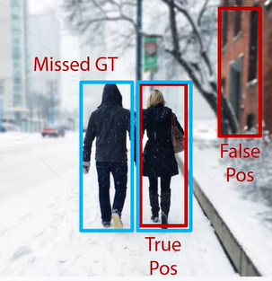
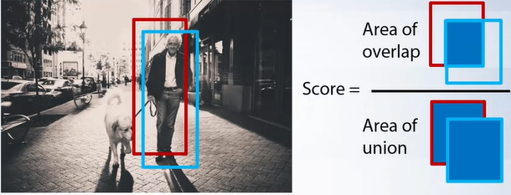
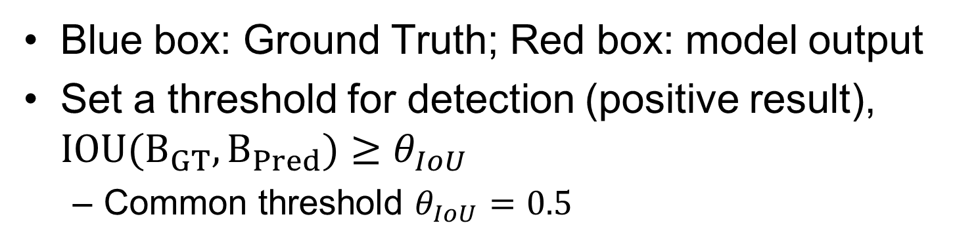
Detection Criteria (Intersection Over Union, IOU)
Blue box: Ground Truth; Red box: model output
Set a threshold for detection (positive result), $IOU(B_{GT},B_{Pred})≥θ_{IoU}$
Common threshold $θ_{IoU}=0.5$

